Slide 1


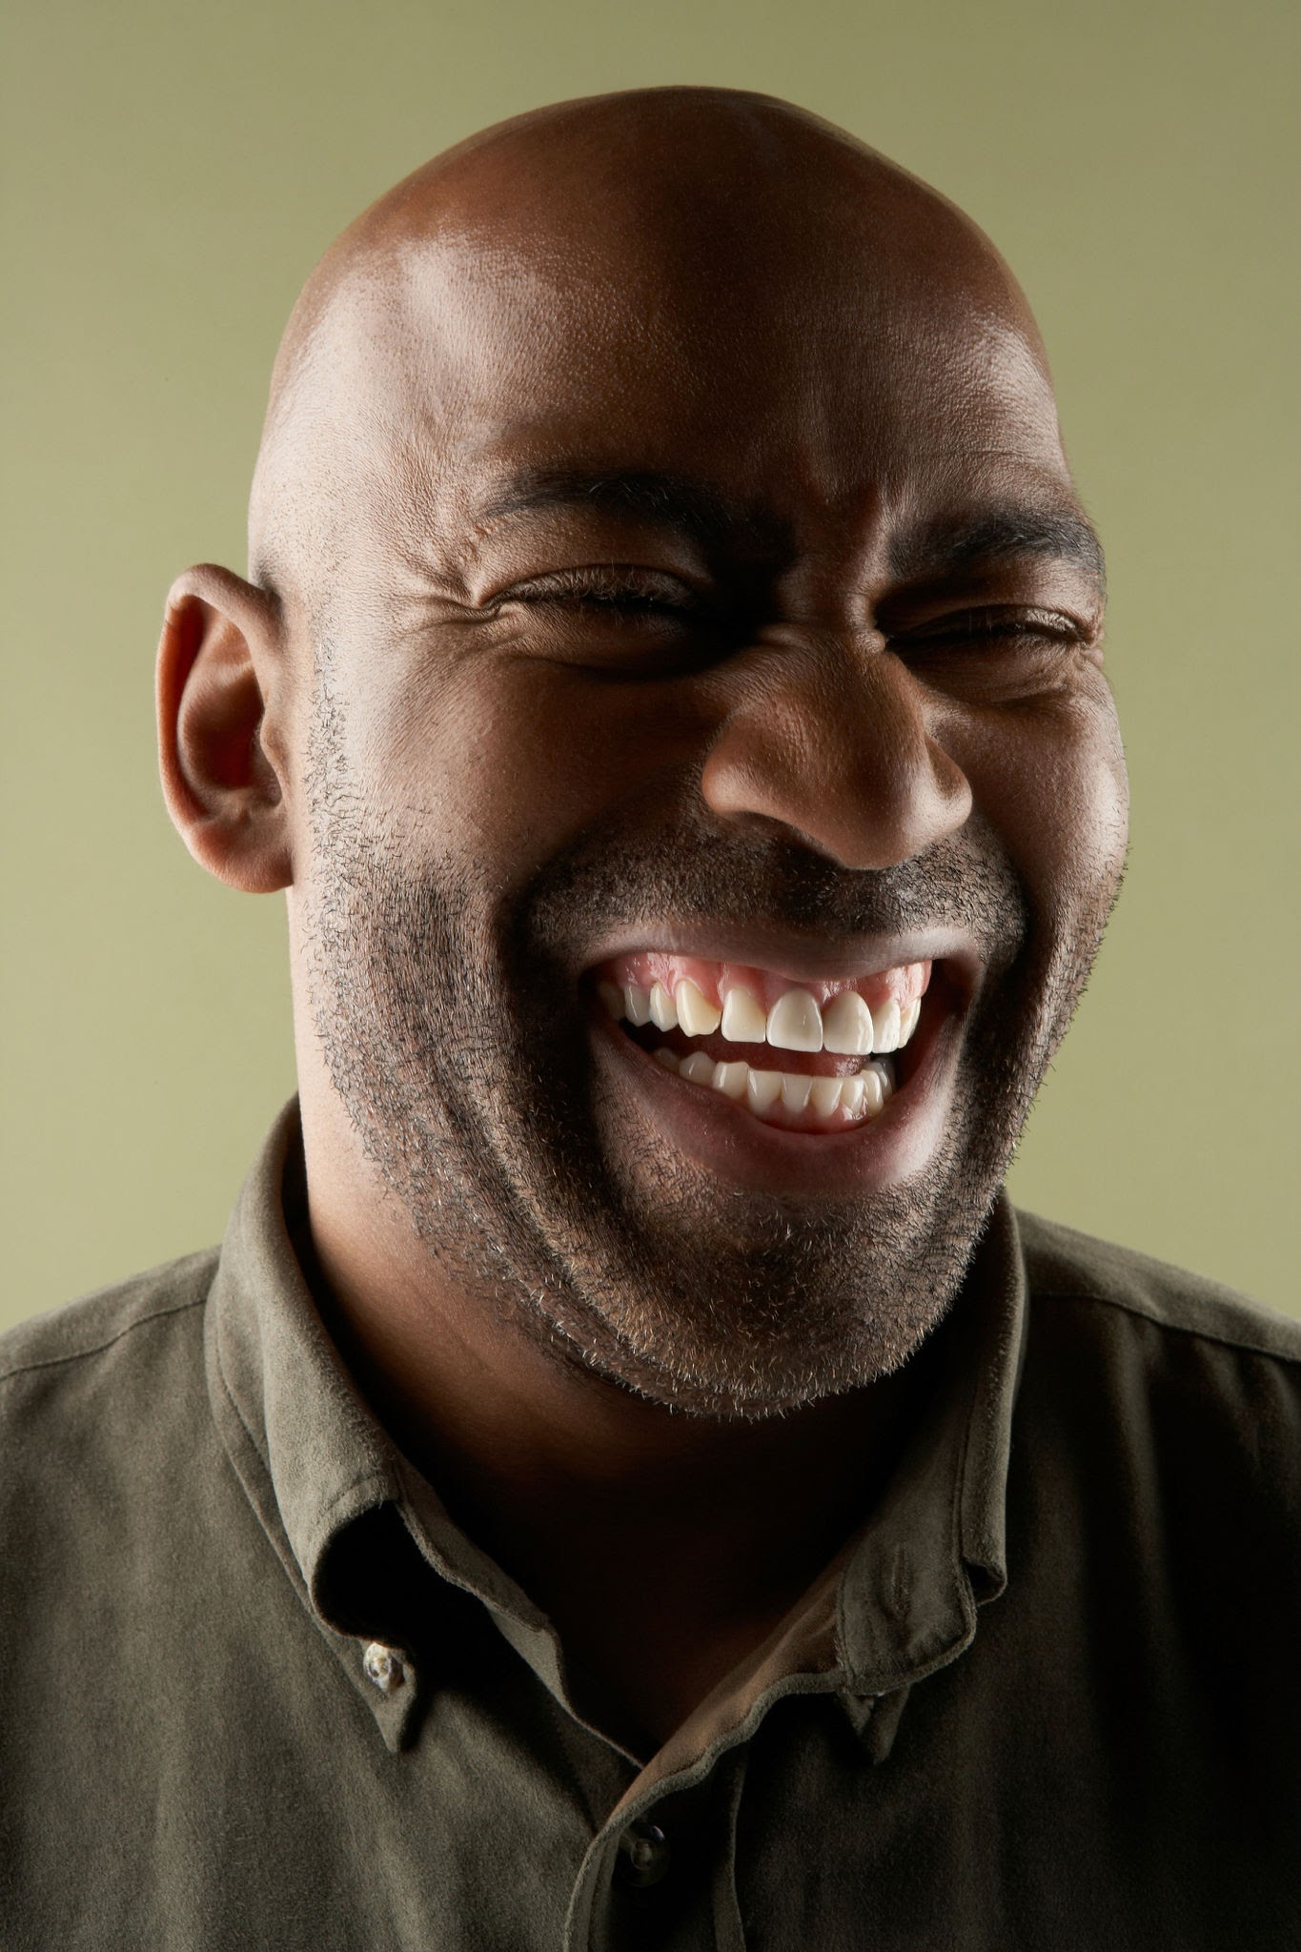

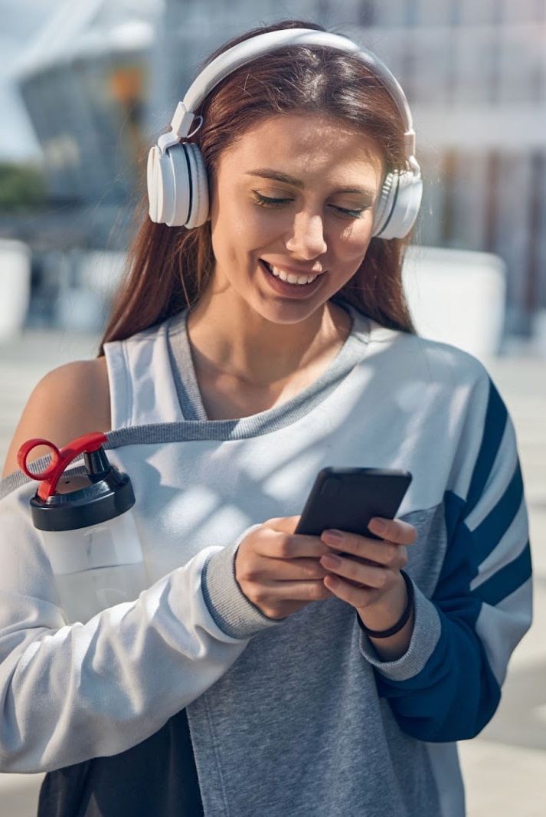


Social
Media
Analysis
Confidential

Slide 2
AGENDA
1
Introduction
2
Objectives and Problem Statement
3
Data Overview
4
Methodology
5
Analysis of Top Users
6
Analysis/Recommendations & Conclusion
Confidential

Slide 3
Introduction
Project Statement
This project uses SQL to analyze user behavior on a social media platform.
The goal is of deriving actionable business insights.
We aim to move from a basic understanding of user activity to a data-driven strategy for growth and community management.
Confidential

Slide 4
Objectives & Problem Statement
We have a massive amount of user data, but we lack a clear understanding of what drives engagement, who our most valuable users are, and how to effectively encourage user activity.
This project addresses these gaps by using advanced SQL queries to analyze key metrics.
Expand market footprint
Re-Engage Inactive Users
Acquire New customers
Identify and Rank Top Users:
Analyze Engagement Patterns
Segment the User Base
Confidential

Slide 5
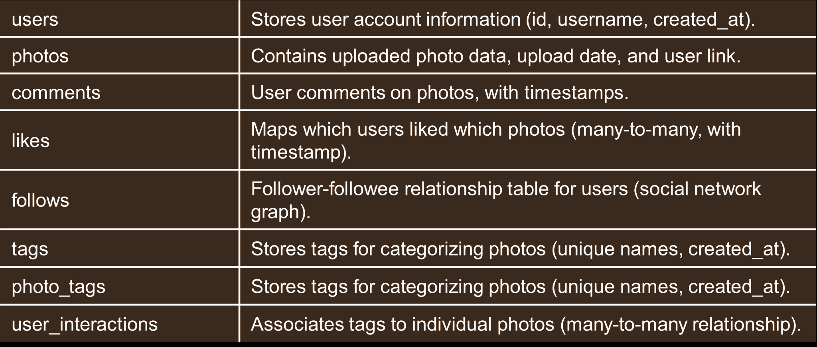
Data Overview
Confidential

Slide 6
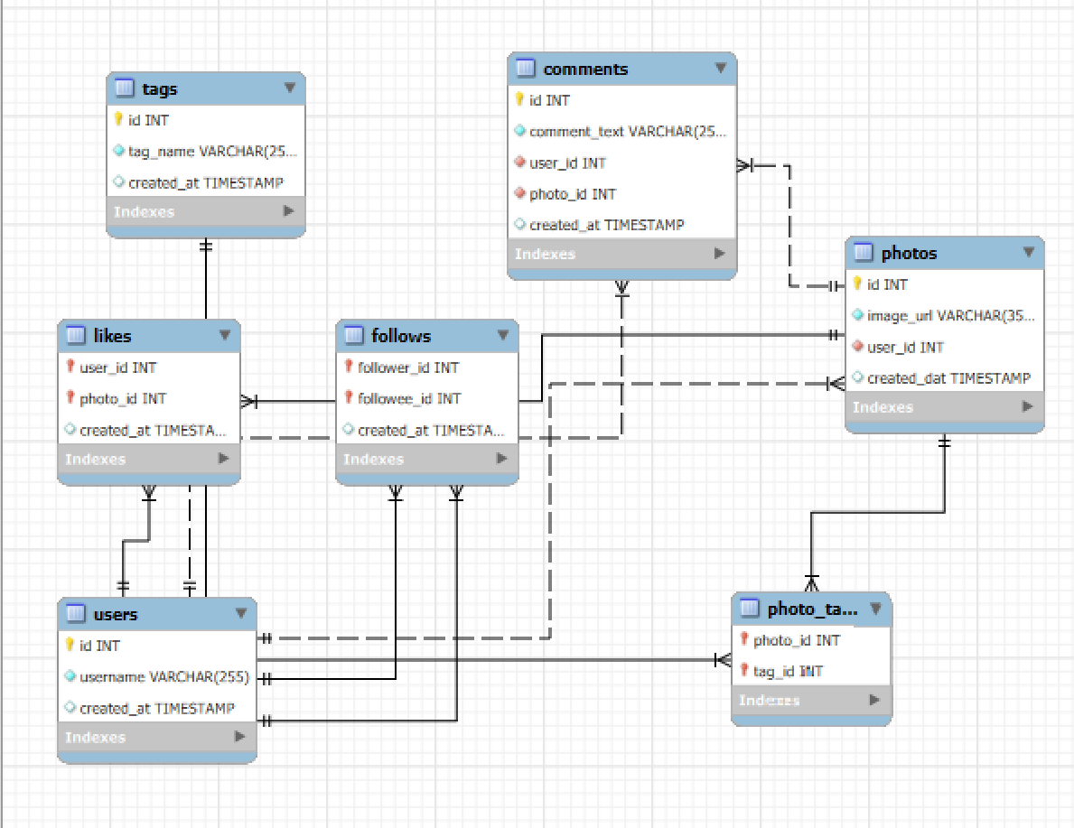
Database Schema
Confidential

Slide 7
Methodology
Analytical Methods and Tools
Our analysis was performed using SQL, leveraging its power to transform raw data into strategic insights.
Data Cleaning: The database schema use of constraints helped maintain data integrity, minimizing the need for extensive cleaning.
Core SQL Operations: We used fundamental operations like JOIN, GROUP BY, and HAVING to aggregate and filter data.
Window Functions: We utilized DENSE_RANK(), SUM() OVER(), and LAG() to rank users, calculate running totals, and analyze sequential behavior.
Common Table Expressions (CTEs): We broke down complex, multi-step queries into readable and manageable parts using WITH clauses.
Conditional Logic: We used CASE statements to create user segments and apply specific logic based on user activity.
Confidential

Slide 8
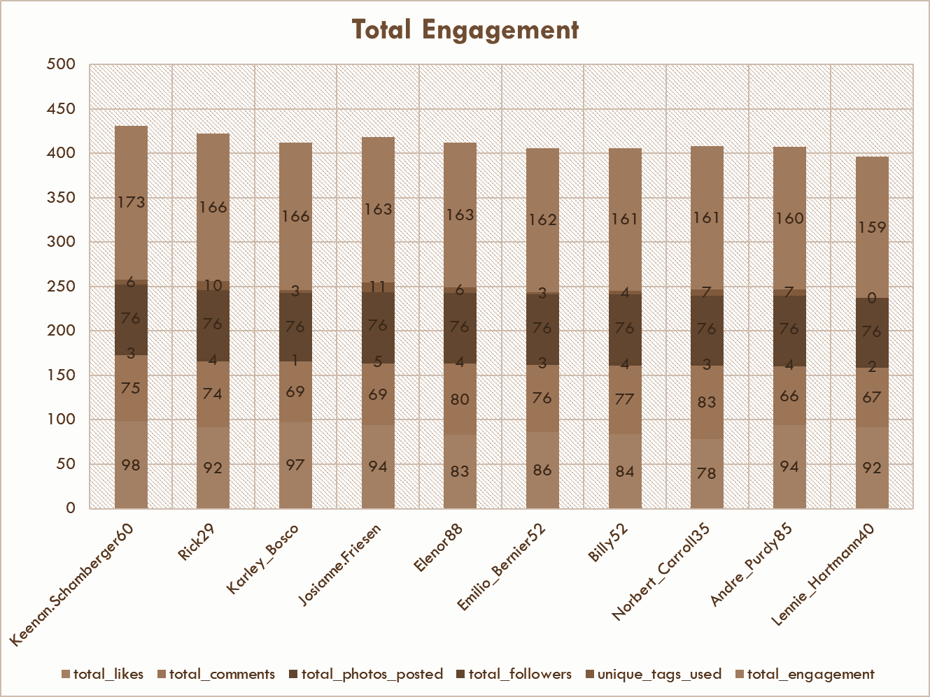
Analysis of Top Users
Finding: The Most Valuable Users Are Not Always the Most Followed.
While follower count is a factor, a high engagement rate is a more direct indicator of a user’s influence and value. Users with a high engagement rate generate significant likes and comments relative to their audience size.
Key Takeaways:
Users with the highest follower counts (e.g., influencers) do not always have the highest engagement rates.
A user with a smaller, highly engaged following is a more valuable brand ambassador.
We can identify these users by calculating a single "Activity Score" that combines their posts, likes, and comments.
Confidential

Slide 9
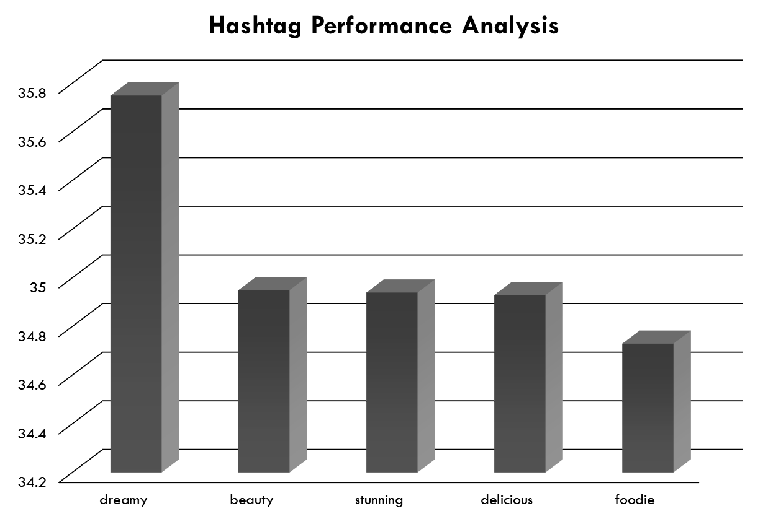

Analysis of Engagement Patterns
Finding: User Engagement Follows Predictable Patterns.
Our analysis of the created_at timestamps revealed clear trends in user behavior.
Key Takeaways:
Peak Posting Times: Content posted during certain hours receives significantly more engagement. Scheduling content for these peak times can maximize its reach.
High-Performing Hashtags: Certain hashtags consistently drive higher average likes per post, indicating topics that resonate most with the audience.
These patterns provide a clear data-driven roadmap for a more effective content strategy.
Confidential

Slide 10
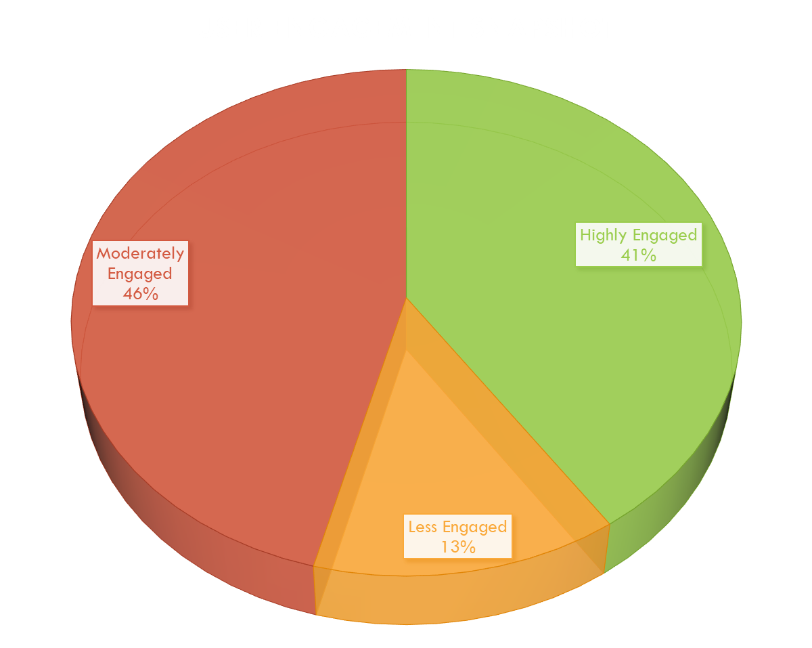
Analysis of User Segmentation
Finding: Users Can Be Segmented into Distinct Behavioral Groups.
Using SQL, we were able to segment the entire user base into four key categories based on their activity levels.
Key Segments:
Content Creators: Users who post frequently.
Super Fans: Users who engage with content heavily (likes, comments).
Community Builders: Users with balanced activity across all metrics.
Inactive Users: Users with little to no recent activity.
Confidential

Slide 11
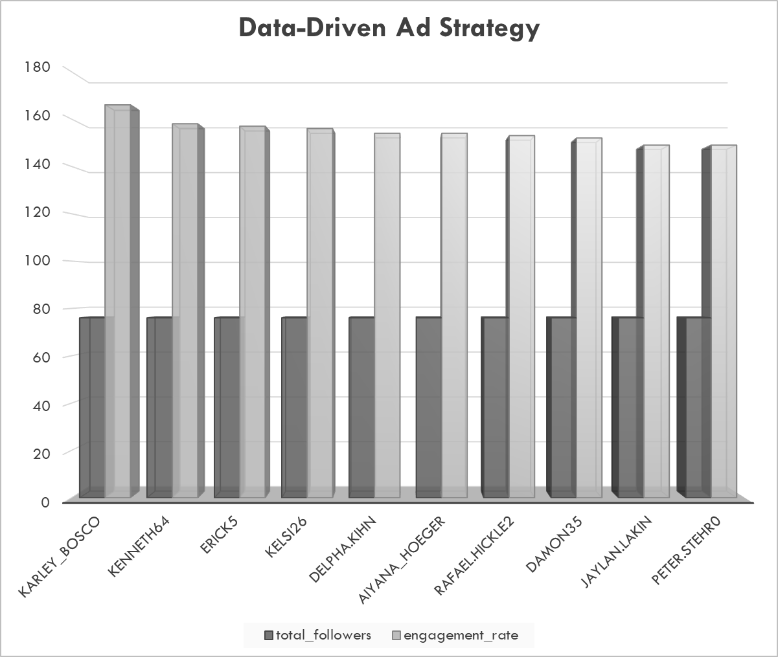
Strategic Recommendations
Recommendation 1: Targeted Re-engagement Campaigns
Based on our analysis of inactive users, we can launch highly personalized campaigns to bring them back.
Data-Driven Reason: We can identify users who have not posted or liked a photo in over 30 days.
Strategy: Send personalized push notifications or emails with a "Top Posts You've Missed" feed based on their past interests.
Expected Impact: Increased user retention and a boost in overall platform activity.
Recommendation 2: Launch a Brand Ambassador Program
Identify and partner with the most influential 'Community Builders' and 'Super Fans' to drive brand initiatives and events.
Data-Driven Reason: We have identified users with a high comment-to-like ratio, indicating they excel at sparking conversation.
Strategy: Offer these users exclusive perks like early access to new features, a verified badge, or a chance to be featured on official channels.
Expected Impact: Increased brand loyalty and authentic word-of-mouth promotion.
Confidential

Slide 12
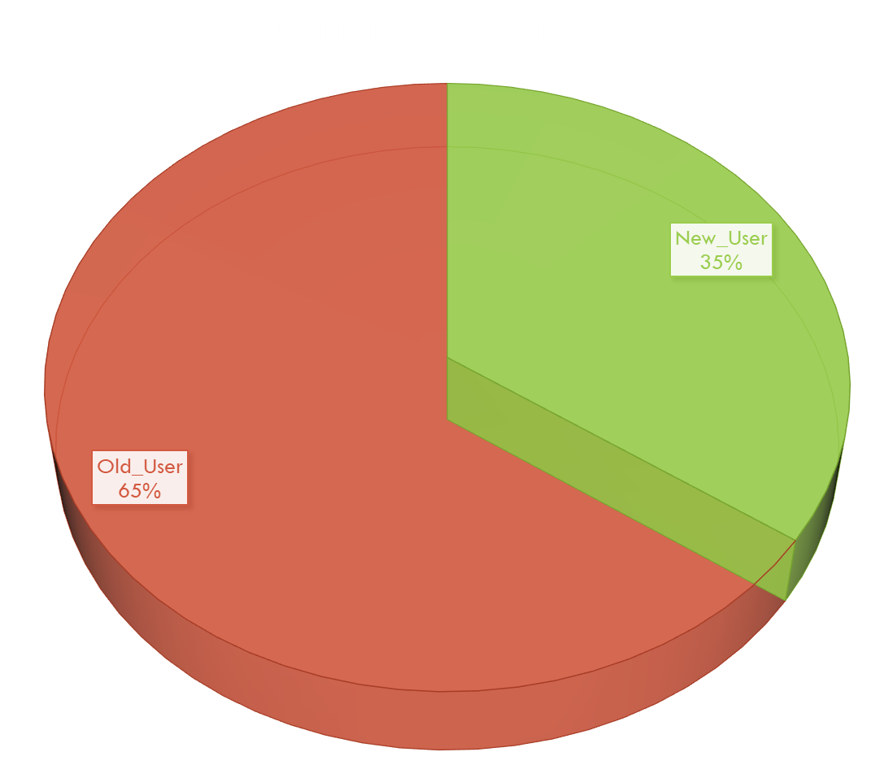
Strategic Recommendations
Recommendation 3: Optimize Content and Advertising
Align content creation and ad campaigns with the most engaging hashtags and posting times.
Data-Driven Reason: Our analysis shows that specific hashtags and posting times consistently outperform others.
Strategy:
Content Teams: Advise creators on which hashtags to use to maximize reach.
Ad Campaigns: Schedule paid campaigns to run during peak engagement hours to increase CTR and conversions.
Expected Impact: Higher ROI on ad spend and more effective content amplification
Confidential

Slide 13
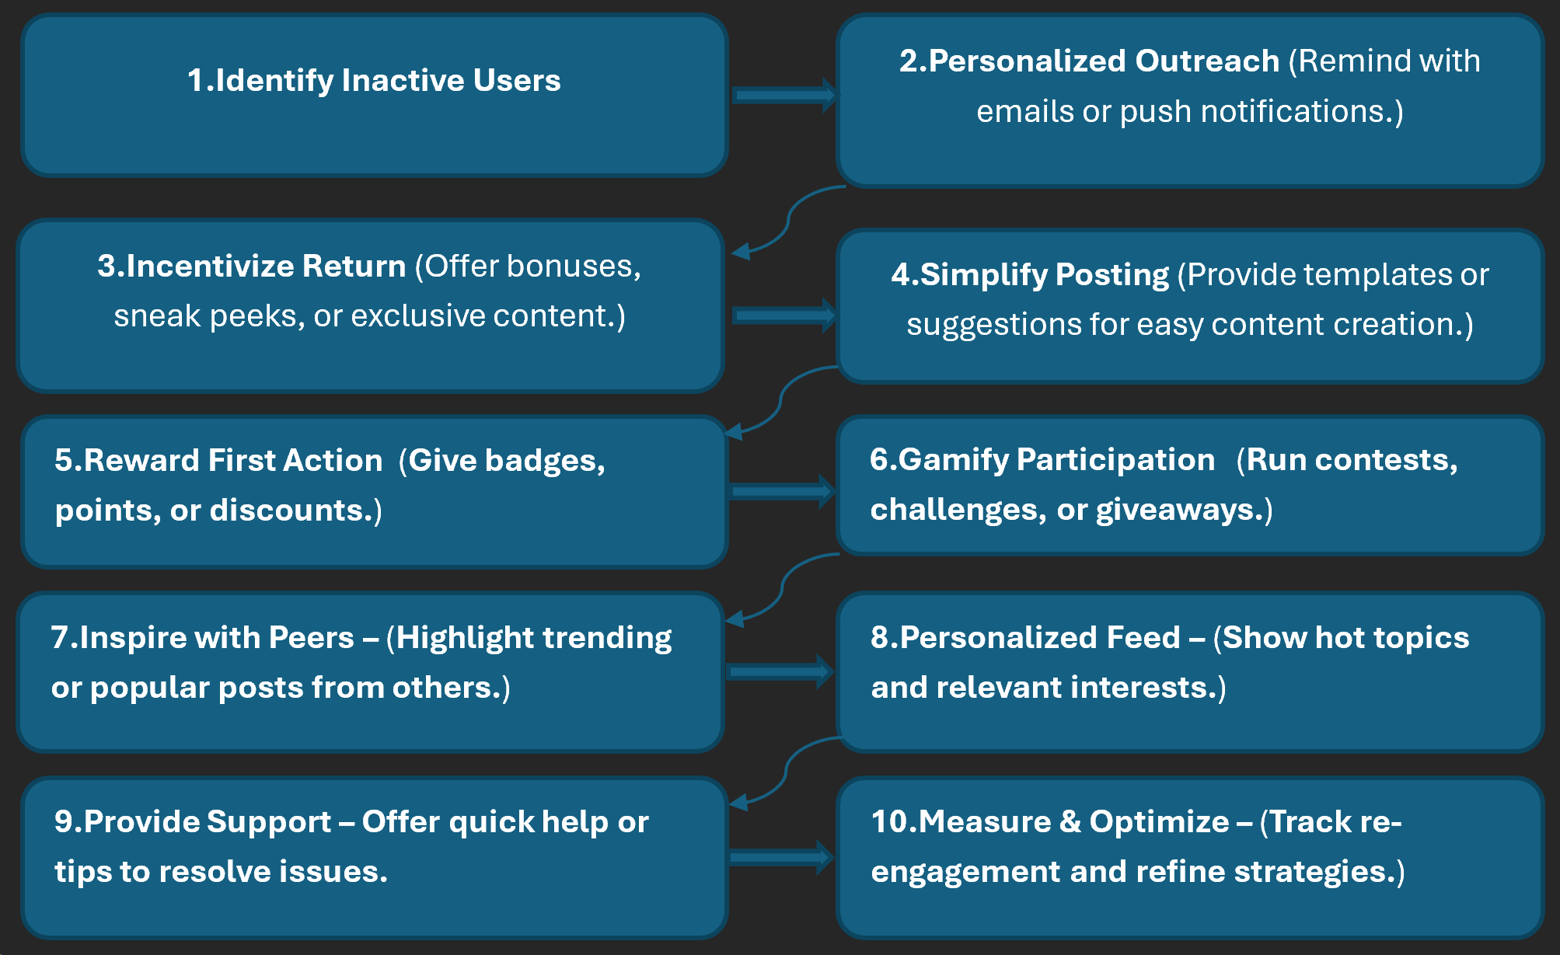
Strategic Recommendations Flow:
Confidential

Slide 14



Conclusion: Key Findings, Implications and Final Statement
Our analysis has provided a clear, data-driven understanding of user behavior. We've moved from simple metrics to a strategic framework for growth, identifying key user segments and actionable insights.
These insights enable a more proactive and personalized approach to content, marketing, and community management. By leveraging our data, we can build a more engaged and loyal user base.
Data is not just about numbers; it's about understanding the people behind them. By listening to what our data tells us, we can build a more vibrant and successful platform.
Confidential

Slide 15
THANK
YOU!
Thank You & Questions?
It has been a pleasure to analyze this data and develop these recommendations. I am happy to answer any questions you may have.
Bhaskar Jha bhaskarskjha@gmail.com

